Slide 1


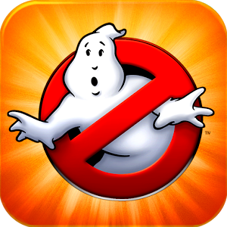




XMG Studio was founded in 2009, located in Toronto, Canada
XMG has released 20 titles on iOS, Android & Amazon Platforms, 6 titles have been awarded industry awards for excellence
10 titles with multi-million downloads and 2 that have reached #1 download ranking worldwide
XMG Studio was named as one of the ‘Top Mobile Games Developers To Watch’ by Pocket Gamer biz in 2012 and was named one of ‘Canada’s 50 Most Engaged Workplaces’ in 2011
Best Artistic App, 2010
– Best App Ever Awards
Best Augmented Reality App, 2012
- Best App Ever Awards
Best App in Style & Beauty, 2012
– iPhone Magazine
Most Innovative Game of the Year, 2011
- Best App Ever Awards
Best in Mobile Applications 2012
– Digi Awards
Best Augmented Reality App, 2009
- Best App Ever Awards

